Slide 1
Pinhole lamp
Kay’s teacher places a bright lamp in front of a very small hole.
Pinhole in card

Slide 2
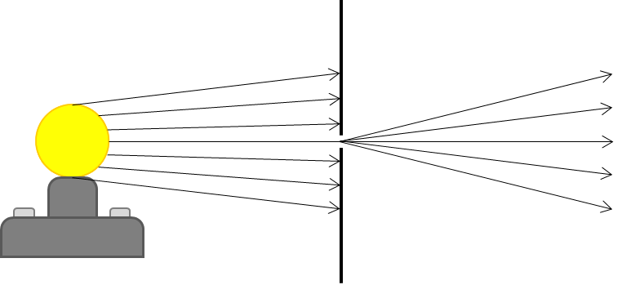
Pinhole lamp
Which diagram best shows how light passes through the pinhole?
A
B
C
D

